Slide 1

Short Form - Expansion
Defining additional Service History criteria
Online Health Apps team

Slide 2
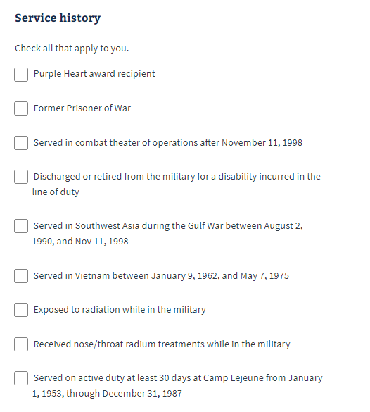
Existing Service History listing
Purple Heart
Verification required
Former Prisoner of War
Verification required, with dates and locations
Served in combat theater of operations after November 11, 1998
Suggestion: Remove this one and keep bullet #5 (duplicates)
Discharged or Retired from the military for a disability incurred in the line of duty
Verification required (DD214 would have this)
Served in Southwest Asia during the Gulf War between August 2, 1990 and Nov 11, 1998
Use this one instead of bullet #3
Verification required
Served in Vietnam between January 9, 1962 and May 7, 1975
Verification required
Financials come through blank sometimes, not needed in some cases
Exposed to radiation while in the military
Verification required
Received nose/throat radium treatments while in the military
Verification required
Served on active duty at least 30 days at Camp Lejeune from January 1, 1953 through December 31, 1987
Verification required
Self-certify with Navy and Marines
Notes:
Means tests (Financial assessments) are also done for some of these items.
Short Form flow skips financial information section, which would not benefit the existing process
Extensive verifications are needed for each service history item listed

Slide 3
Thank you

